Slide 1
DEVELOPMENT OF AN ONLINE WRITING ASSISTANT FOR TOXIC LANGUAGE PREVENTION Final Defense By Alonge Daniel Oluwasegun 170404063 Department of Computer Science, Adekunle Ajasin University Akungba Akoko Ondo State Nigeria.

Slide 2
ABSTRACT
There is a need for a writing assistant tool that checks for the presence and prevent the use of toxic contents in online communication system. The growth of online communication has created various problems such as privacy, lack of job security, unruly cultures, and toxic words. Toxicity in online communication can be manifested in different ways, including hate speech, cyberbullying, trolling, xenophobia, racism, and sexism. Thus, the aim of this research is to develop a writing assistant that prevents the use of toxic language in online communication system. The objectives are to Develop a writing assistant for online forum, develop an integrated dictionary, machine learning and perspective API model for toxic language detection, implement a writing assistant for toxic language prevention base on (ii)
The tools used in this study include a dictionary-based approach, machine learning, and the Perspective API for detecting toxic language in online communication. The writing assistant tool was developed to prevent the successful entry of toxic words and phrases in online forums. The study highlights the potential of using software agents, including machine learning and the Perspective API, in developing more sophisticated tools to detect and suggest alternative phrases for toxic language. Overall, the study aims to reduce the prevalence of toxicity in online communication and promote a more positive online environment.
Keywords: Toxicity, Communication, Writing Assistant, Dictionary-based approach, Machine Learning, Perspective API.

Slide 3
BACKGROUND TO THE STUDY
The Oxford Advanced Learner’s Dictionary of Current English (2004) defines communication as the activity or process of expressing ideas and feelings or of giving people information. Giffin & Patten (1976) also state that communication is the process of creating meaning as well as ascribing it. It is the exchange of ideas and interaction among group members.
More and more information is being churned out online ever than before. There is a lot of information for the reader to read online. People have started doing everything online, including but not limited to banking, reserving tickets, booking travel, planning travel, Every other activity which is possible is being done online..
Over the years’ online communication has been affected with different problems which include: Lack of privacy, Overruling culture and use of Toxic Words

Slide 4
BACKGROUND TO THE STUDY CONT’D
According to research on computer-mediated communication by Lincoln Dahlberg and others. A term now heavily used by reporters, “trolling” is frequently used interchangeably to refer to bullying and hate speech, muddying the waters around the word’s definition and descriptive power. Toxicity can be manifested in different ways. It spans a wide spectrum that includes subtle and indirect signals; that can often be no less toxic than overly offensive language (Jurgens et al., 2019).
The Ever increasing toxicity in online communication has given rise to the need of writing assistant tools that help prevent the use of toxic words in online communication in real time.
Having consider the problems attached to online communication this work will be focusing on the use of Toxic words. Which will lead to the development of a tool called Toxic Checker.
The researcher will be developing a writing assistant tool that check for the presence of toxic words in a text and prevent it from been sent.

Slide 5
RELATED WORKS
Waseem et al. (2018)
Chatzakou et al. (2017)
Zampieri et al. (2019a) SemEval-2019 Task 6
Devised a taxonomy and created a dataset to detect hate speech and discrimination. In this paper, they identified the multiple influences on the detection of toxic exchange beyond conventional content analysis. For toxicity detection they provided a framework founded on behavioral and social theory However, one limitation of the study is that it focuses only on hate speech, and does not address other types of toxic language such as harassment and bullying.
The work is motivated by the need to test and provide a system that categorizes emotion in online activities. The main contributions of this work are to: (a) detect primary emotions, social ones, and those that characterize general affective states from online text sources, (b) compare and validate different emotional analysis processes to highlight those that are most efficient, and (c) provide a proof of concept case study to monitor and validate online activity, both explicitly and implicitly. They used soft classification techniques (Naïve Bayes classifier) to produce the class membership of probabilities of each tweet. Limitations include the need for manual feature engineering and potential difficulties in handling sarcasm and irony.
Identifying and Categorizing Offensive Language in Social Media (OffensEval) The task was based on a new dataset, the Offensive Language Identification Dataset (OLID), which contains over 14,000 English tweets. It featured three sub-tasks. In sub-task A, the goal was to discriminate between offensive and non-offensive posts. In sub-task B, the focus was on the type of offensive content in the post. Finally, in sub-task C, systems had to detect the target of the offensive posts. The evaluation results have shown that the best systems used ensembles and state-of-the-art deep learning models such as BERT. Overall, both deep learning and traditional machine learning classifiers were widely used. They released a corpus for offensive posts named OffensEval which has been encouraging researchers to study offensive contents.

Slide 6
STATEMENT OF THE PROBLEM
The problem was actually motivated by the urge to totally eliminate the use of toxic language in online communication, which has led to the withdrawal of some people from the online environment with the aim of avoiding hate speech and online bully.
To address the problem of toxic language in online communication, a solution will be developed that utilizes a combination of approaches, including a dictionary of offensive words and phrases, machine learning algorithms, and the Perspective API model.
The urban dictionary will serve as a reference guide for identifying and flagging offensive language, while the machine learning algorithms will be trained on large datasets of past instances of hate speech and online bullying to improve their accuracy in identifying such language.
The Perspective API model, which has been specifically designed to identify toxic language, will also be utilized to enhance the accuracy of the system. This model uses machine learning to analyze text and detect patterns that indicate whether the language is toxic or not.
Overall, this solution aims to create a safer and more inclusive online environment by automatically detecting and filtering out toxic language in online communication. This will help to prevent individuals from experiencing online harassment and ensure that everyone feels welcome and respected in online communities.

Slide 7
MOTIVATION OF STUDY
The problem was actually motivated by the urge to totally eliminate the use of toxic language in online communication, which has led to the withdrawal of some people from the online environment with the aim of avoiding hate speech and online bully.

Slide 8
AIM AND OBJECTIVES
The aim of the research is to develop a writing assistant that help prevent the use of toxic language in online system and the specific objectives are as follows:
Develop a writing assistant for online forum
Develop an integrated dictionary, machine learning and perspective API model for toxic language detection
Implement a writing assistant for toxic language prevention base on (ii)

Slide 9
SCOPE OF THE STUDY
The work is focus on the prevention of individual toxic words that is commonly use across popular social media platforms which include facebook, blog posts, twitter and whatsapp but will be implement on a small blog page.

Slide 10
METHODOLOGY
The aim of this research is to develop a blog web app and prevent users from using toxic words or phrase in the community in achieving this aim the researcher use the waterfall model. The waterfall model is a traditional approach to software development that follows a linear and sequential process. The waterfall model has several stages, and each stage must be completed before the next one can begin. The stages of the waterfall model are as follows:
Requirements gathering: In this stage, the researcher gathers information about the requirements for the writing assistant tool. This includes the types of toxic words and phrases to be detected and prevented, the programming language to be used, and the platform on which the tool will be implemented.
Design: In this stage, the researcher designs the architecture of the writing assistant tool. This includes the algorithms to be used for detecting and preventing toxic words, the blog page, the user interface design, and the database design.
Implementation: In this stage, the researcher begins coding the writing assistant tool based on the design specifications. The programming language chosen for the implementation was python for the web development and the data base and also JavaScript for the tool responsiveness.

Slide 11
METHODOLOGY CONT’D
Testing: In this stage, the researcher tests the writing assistant tool to ensure that it meets the requirements gathered in the first stage. This includes testing for the detection and prevention of toxic words and phrases, as well as testing the user interface and database functionality.
Deployment: The System wasn’t deploy online but only function on the local server.
Maintenance: In this stage, the researcher performs regular maintenance on the writing assistant tool to ensure that it continues to function as intended. This includes updating the tool with new toxic words and phrases as they emerge and fixing any bugs or issues that are discovered.
The waterfall model was chosen for this work because it provides a structured approach to software development that ensures that each stage is completed before moving on to the next one. This helps to prevent errors and issues from being carried forward into subsequent stages, which can lead to significant problems down the line. Additionally, the linear and sequential nature of the waterfall model makes it easier to plan and manage the development process, which is important for ensuring that the project is completed on time and within budget.

Slide 12
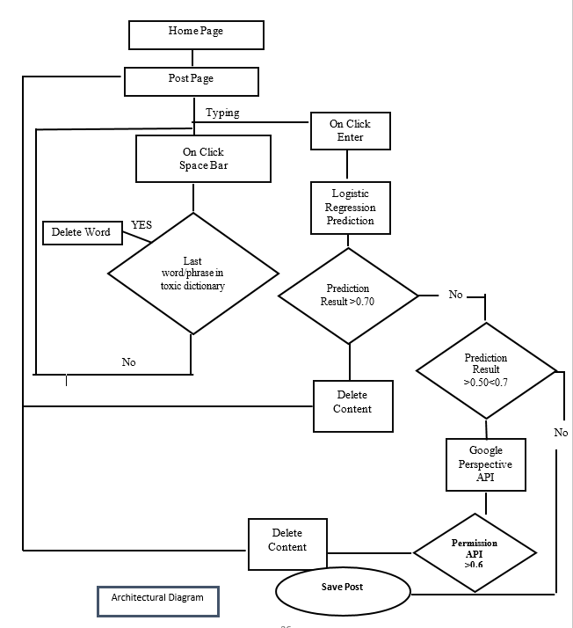
METHODOLOGY CONT’D
System Architecture

Slide 13
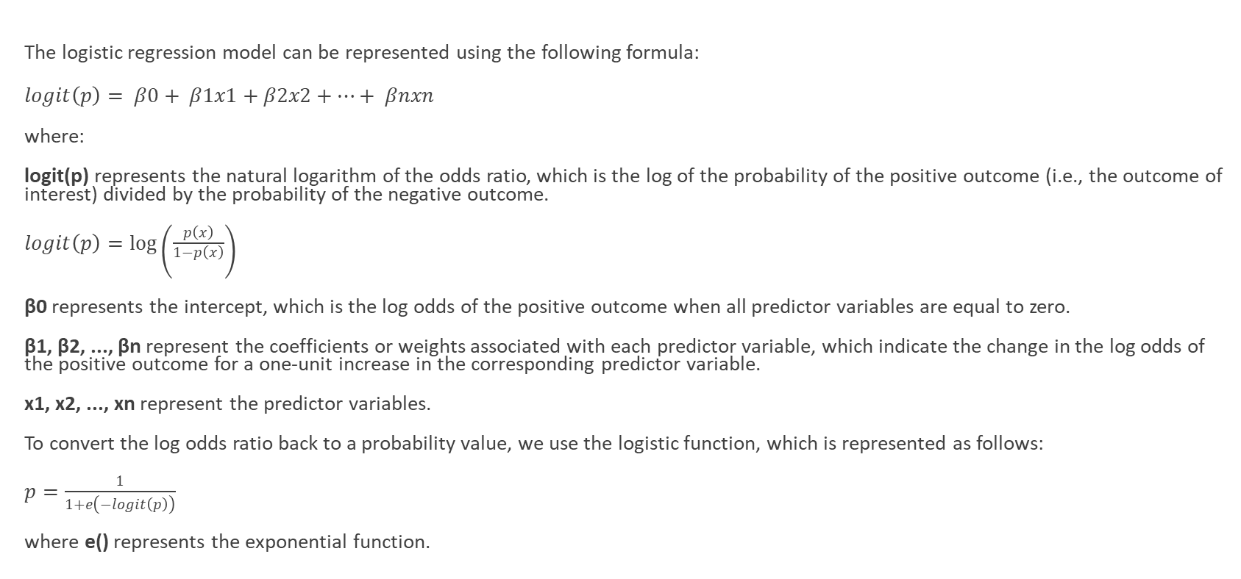
METHODOLOGY CONT’D
The logistic regression model can be represented using the following formula:
$logit\left(p\right)= β0+ β1x1+β2x2+…+ βnxn$
where:
logit(p) represents the natural logarithm of the odds ratio, which is the log of the probability of the positive outcome (i.e., the outcome of interest) divided by the probability of the negative outcome.
$logit\left(p\right)=\log\left(\frac{p\left(x\right)}{\begin{aligned}1−p\left(x\right) \\ \end{aligned}}\right)$
β0 represents the intercept, which is the log odds of the positive outcome when all predictor variables are equal to zero.
β1, β2, ..., βn represent the coefficients or weights associated with each predictor variable, which indicate the change in the log odds of the positive outcome for a one-unit increase in the corresponding predictor variable.
x1, x2, ..., xn represent the predictor variables.
To convert the log odds ratio back to a probability value, we use the logistic function, which is represented as follows:
$p=\frac{1}{1+e\left(−logit\left(p\right)\right)}$
where e() represents the exponential function.

Slide 14
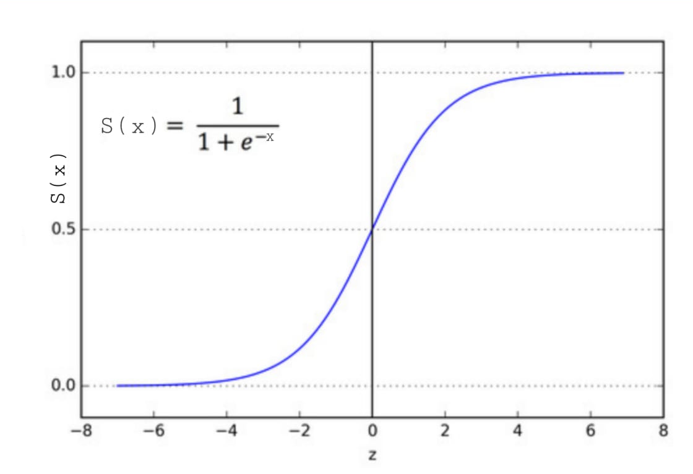

Slide 15
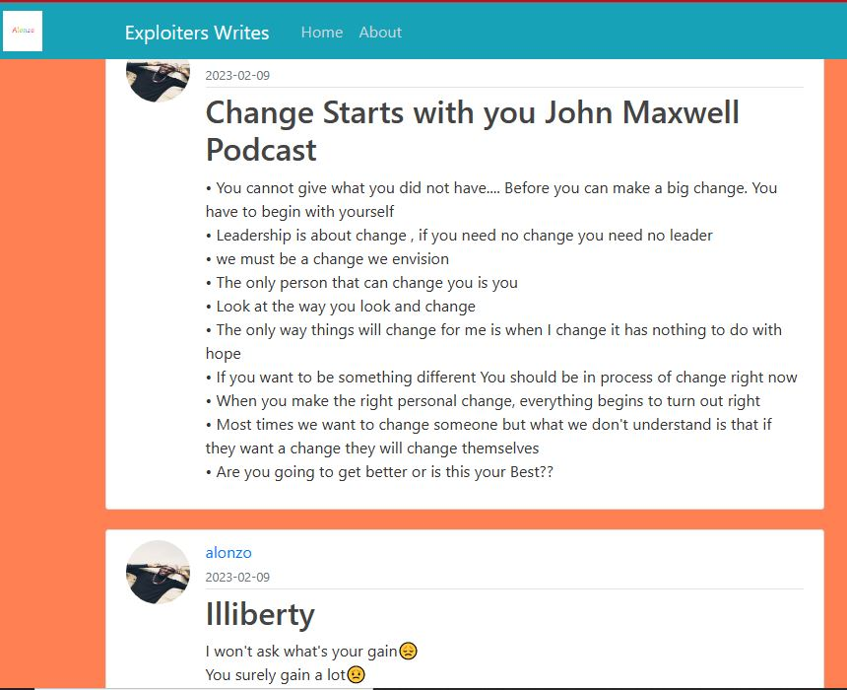
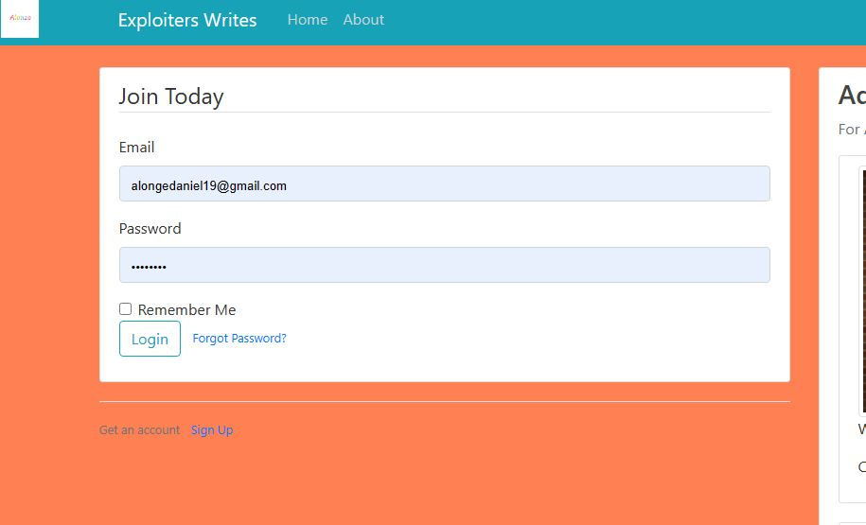
IMPLEMENTATION
After thorough research on how a blog page works we then after develop a blog page called the exploiter page, although it’s not as sophisticated as the blog websites in the real world scenario but it’s suitable and large enough for the purpose of this research.
HOMEPAGE
LOGIN PAGE

Slide 16
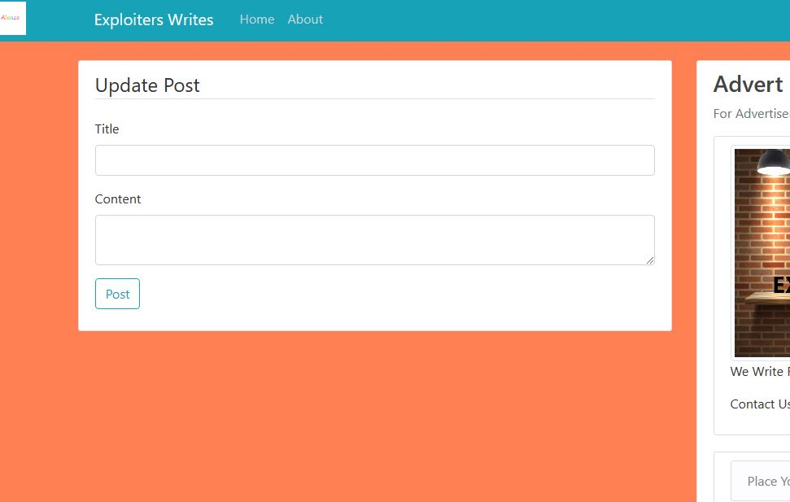
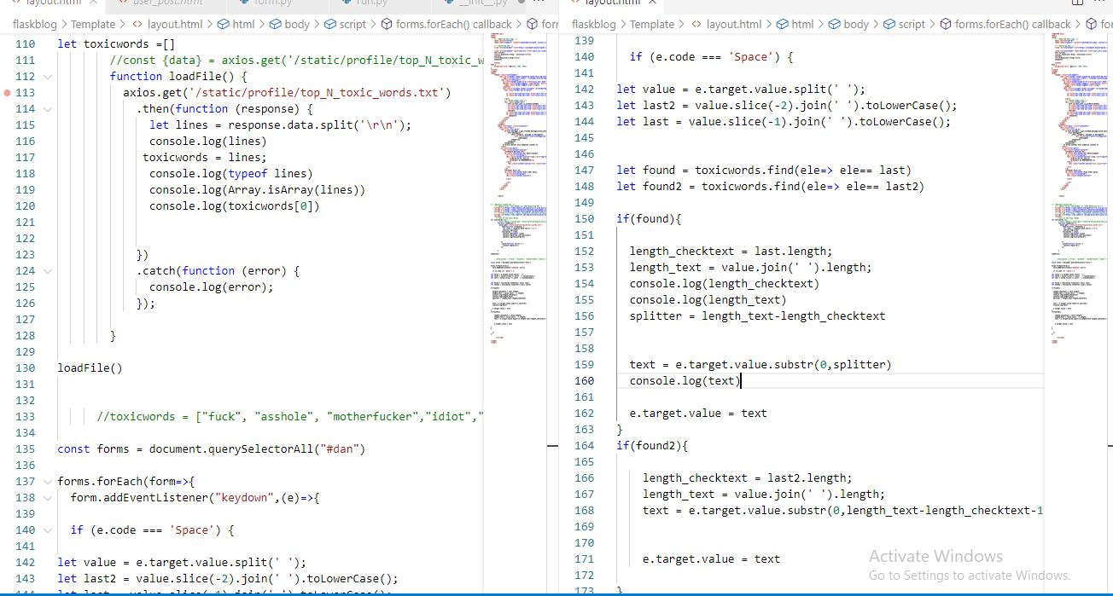
IMPLEMENTATION CONT’D
POST PAGE
JavaScript code that check for user input in toxic dictionary

Slide 17
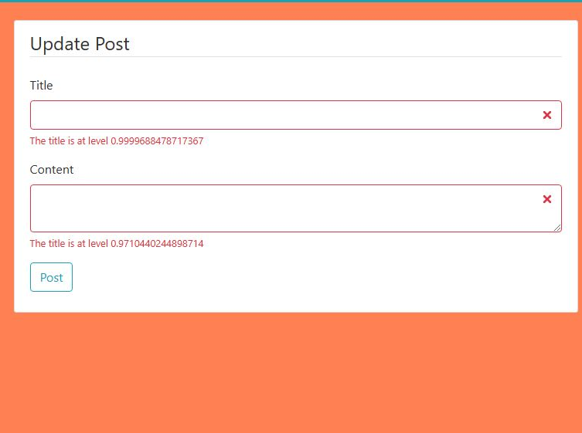
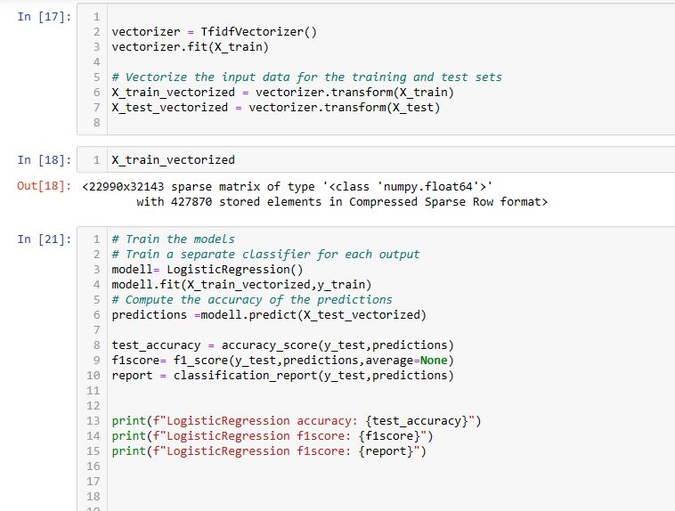
IMPLEMENTATION CONT’D
RESULT PAGE
MODEL BUILDING

Slide 18
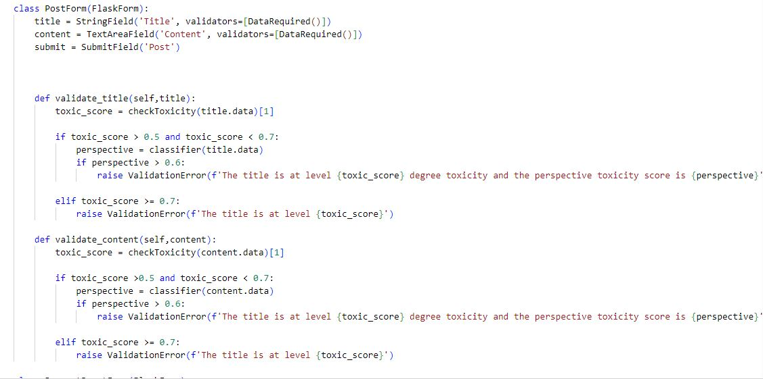
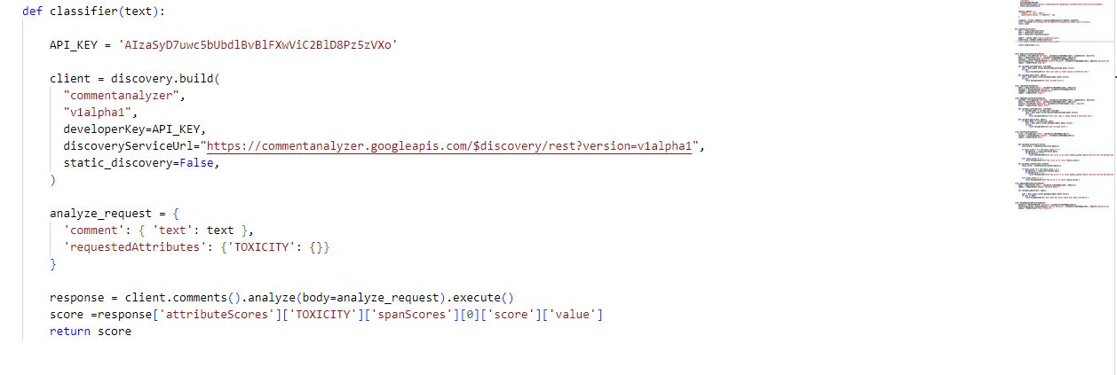
IMPLEMENTATION CONT’D
PERSPECTIVE API
VALIDATION CHECK

Slide 19
CONTRIBUTION TO KNOWLEDGE
On completion of this work we should now have a tool that detect and filters toxic contents allowing users to send the message.

Slide 20
SUMMARY
The Ever increasing toxicity in online communication has given rise to the need of writing assistant tools that help prevent the use of toxic words in online communication in real time. Writing assistant tools are tools that help check for a specified error in writing and help in correcting or preventing them. AI writing assistants have come a long way since a Stanford student created the first spell-check software in the early 1970s. Since then, spell check, grammar checking, and autocorrect functionality have become commonplace, and people expect artificial intelligence to help them in their daily lives.
The study found that toxicity is a major issue in online communication, and there is a need for tools that can help reduce its impact. The writing assistant tool developed in this study is a step towards addressing this issue. The tool was designed to prevent the use of toxic words and phrase when a user tries to. The study also found that software agents can be useful in developing writing assistant tools.
This study aimed to develop a writing assistant that help prevent the use of toxic language in online by developing a dictionary of toxic words and phrases, and then developing an agent to sense toxic constant once keyed and prevent it. To achieve this aim, the study employed a dictionary-based approach together with machine learning and perspective API in developing the writing assistant tool.
Integration: In developing the writing assistant, the model for text classification and online forum for the exhibition, the following tools were used: Visual Studio code, Flask (Python web framework), JavaScript, HTML, CSS, Bootstrap, and more. The integration of the writing assistant into the online forum was achieved through the use Dictionary model, Machine learning algorithm using logistic regression and also perspective API. The writing assistant was able to detect and prevent the use of toxic words and phrases in real time, thereby reducing the impact of toxicity in online communication.
Limitation: The research has some limitations that should be noted. First, the tool developed in this research is limited to detecting toxic language in English only. Second, the tool may not be effective in detecting certain types of toxic language, such as sarcasm or irony. Third, the tool relies on a dictionary-based approach, which may not be effective in detecting new or evolving forms of toxic language. Fourth, the tool may generate false positives or false negatives, which may affect its effectiveness.
Contribution: This research makes several contributions to the field of online communication and writing assistant tools. First, it provides a solution to the problem of toxicity in online communication, which is a significant issue in today's society. Second, it demonstrates the effectiveness of a dictionary-based approach in detecting toxic language in real-time. Third, it contributes to the growing body of knowledge on writing assistant tools and their applications in different domains.

Slide 21
CONCLUSION
In conclusion, this study developed a writing assistant tool that can assist in reducing toxicity in online communication. The tool was designed using a dictionary-based approach and prevent the successful entry of words when a user inputs a toxic word or phrase. The study found that software agents can be useful in developing writing assistant tools and that further research is needed to develop more sophisticated tools that can detect and suggest alternative phrases for toxic language.

Slide 22
REFERENCES
Ben Miller. (2018). Notoriously Toxic: Understanding the Language and Costs of Hate and Harassment in Online Games [Working Paper].
Daniel, I.O.A. (2013). Communication as socio-cultural meaning exchange. The example of Richard Wright’s Black Boy. International Journal of Applied Linguistics and English Literature, 2(5), 173-177.
Dang, Y., Zhang, Y., & Chen, H. (2010). A lexicon-enhanced method for sentiment classification: An experiment on online product reviews. IEEE Intelligent Systems, 25(4), 46-53.
Hosseini, H., Kannan, S., Zhang, B., & Poovendran, R. (2017). Deceiving Google’s Perspective API built for detecting toxic comments. arXiv preprint arXiv:1702.08138.
Jun-Ming Xu, Kwang-Sung Jun, Xiaojin Zhu, & Amy Bellmore. (2012). Learning from bullying traces in social media. In Proceedings of the 2012 Conference of the North American Chapter of the Association for Computational Linguistics: Human Language Technologies (pp. 656-666).
Kelm, O. (1992). The use of synchronous computer networks in second language instruction: A preliminary report. Foreign Language Annals, 25(5), 441-454.
Marcos Zampieri, Shervin Malmasi, Preslav Nakov, Sara Rosenthal, Noura Farra, & Ritesh Kumar. (2019). Predicting the type and target of offensive posts in social media. In Proceedings of the 2019 Conference of the North American Chapter of the Association for Computational Linguistics: Human Language Technologies, Volume 1 (Long and Short Papers) (pp. 1415-1420).
Nwana, H., & Ndumu, D. (1996). A brief introduction to software agent technology. Unicom seminar on "Real-world applications of intelligent agent technology," London UK, 6/11-13/96, 278-292.
Pang, B., Lee, L., & Vaithyanathan, S. (2002). Thumbs up? Sentiment classification using machine learning techniques. In Proceedings of the ACL-02 conference on Empirical methods in natural language processing, Vol. 10 (pp. 79-86).

Slide 23
THANK YOU

